Slide 1
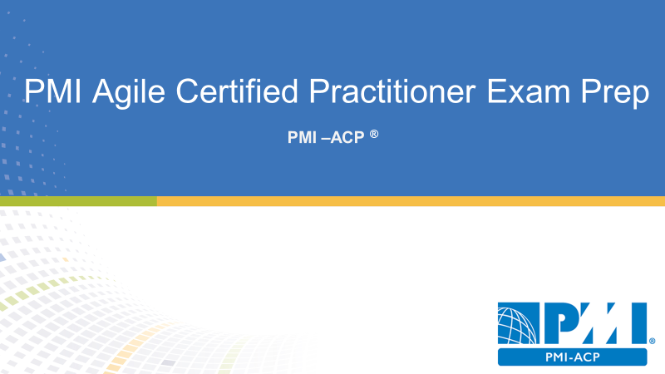
Domain IV
Team Performance
16 % of PMI-ACP Exam
19 Questions

Slide 2
Team Performance
Team Performance Overview |Building an Agile Team |Collaborative Team Spaces | Tracking Team Performance

Slide 3

Agenda
Team Performance Overview
Building an Agile Team
Collaborative Team Spaces
Tracking Team Performance

Slide 4
Team Performance Overview
Overview

Slide 5
Team Performance Tasks
Develop team rules and processes to foster buy in
Help grow team interpersonal and technical skills
Use generalizing specialist
Empower and encourage emergent leadership
Learn team motivators and demotivators
Encourage communication via collocation in collaboration tools
Shield team from distractions
Align team by sharing project vision
Anchor team to measure velocity for capacity and forecast

Slide 6
Develop and Support Self-Organizing Teams
Self-organizing
Self-empowered
The project team are stakeholders
Team leaders
Scrum masters

Slide 7
People over Processes
People are more important and processes
Focus on the people
Servant leadership

Slide 8
Development Team | Delivery Team
Coders
Writers
Analyst
Testers
People can perform multiple jobs in switch from role-to-role

Slide 9
Development Team | Delivery Team
Build the product increments
Update information radiators
Self organize and self direct
Share progress through daily standup meetings
Right acceptance test
Test and revise the product increments
Demonstrate completed increments
Hold iteration retrospective
Estimate the stories and task

Slide 10
Business Representatives
Product owner
Customer
Proxy customer
Value management team

Slide 11
Business Representatives
Prioritize product features
Manages the product backlog
Ensures a shared understanding
Provides the acceptance criteria
Makes change request
May change the product features and priorities
Facilitate engagement of external project stakeholders
Provides due date for the project
Attends planning meetings reviews and retrospectives

Slide 12
Scrum Master
Coach or team leader
Servant leader
Helps the delivery team self-govern and self organize
Facilitator and communicator
Coach and mentor to the delivery team
Guides agile processes
Helps the product owner manage the product backlog
Helps the product owner communicate
Facilitates meetings
Follows up on issues

Slide 13
Project Sponsor
The main advocate for the project
Provides direction to the product owner
Determines value on time and on budget
May attend iteration review meetings
Authorizes the project

Slide 14
Building an Agile Team
How to build an agile team

Slide 15
Team Characteristics
12 or fewer members
Team members have complementary skills
Team members are generalizing specialist
Team members are committed to a common purpose
Team members hold themselves mutually accountable
Team members have shared ownership for the project outcome

Slide 16
Defining Generalizing Specialist
Team members can serve in multiple roles
Team members can easily switch between rules
Helps to resolve bottlenecks

Slide 17
Characteristics of High Performance Teams
Create a shared vision for the project team
Set realistic goals
Limit team size to 12 or fewer people
Build a sense of team identity
Provide strong leadership

Slide 18
8 Characteristics of High Performance Teams
Self-organizing
Empowered
Believe that as a team they can solve any problem
Committed to team success
Owns its decisions and commitments
Motivated by trust
Consensus driven
Participate in constructive disagreement

Slide 19
Self Organizing Teams
Not command and control
Can use their own knowledge to organize work
Structure that work based on iteration goals
Responsibility delegated to the team

Slide 20
Self-Directing Teams
Empowered to work collectively
Make local decisions
Estimate and decide the project work
Make mistakes and learn from mistakes

Slide 21
Defining Emergent Leadership
Different people lead different initiatives
High-performing teams allow multiple leaders
No power struggle when leaders change roles
Leaders are self-selected not assigned

Slide 22
Experimenting and Failing Safely
The team should experiment and try new approaches
It’s okay to fail
Learn from failure and move forward
An engagement culture rewards people for problem solving collaboration and sharing ideas

Slide 23
Encourage Constructive Disagreement
Debate and conflict is natural and healthy
Constructive conflict leads to better decisions and buy-in
Divergence means the team will argue and debate
Convergence means the team will agree on the best solution

Slide 24
Five Dysfunctions of a team
Absence of trust
Fear of conflict
Lack of commitment
Avoidance of accountability
Inattention to results

Slide 25
Shu-Ha-Ri Model of Skill Mastery
Shu: obeying the rules to keep protect or maintain
Ha: consciously moving away from the rules; Ha means to detach or break free
Ri: unconsciously finding an individual path; Ri means to go beyond or transcend
Explanation
Shu –start by following the rules
Ha –once the team has mastered the guidelines they can move away from them and work intuitively
Ri–the team reaches full mastery and can transcend the rules

Slide 26
Dreyfus Model of Adult Skill Acquisition
Novice
Follow the rules they’ve been given and make analytical decisions
Advanced beginner
Still following the rules but based on experience better understand the context of the rules
Competent
Determining which rules are best for each situation
Proficient
Actively choosing the best strategy rather than simply relying on the rules
Expert
Decision-making becomes intuitive

Slide 27
Tuckman Model of Team Formation & Development
Tuckman Model Of Team Formation And Development
Forming–the team comes together and learns about each other
Also known as a working group
Storming–conflict and struggle for the approach and leadership
Also known as a pseudo team
Norming–the team works with each other and conflict has settled
Also known as a potential team
Performing–the team hits their stride
Also known as a real team and becoming a high-performing team

Slide 28
Adaptive Leadership
Directing –happens during team forming
Team members may have low competence but high commitment
Leaders hi directive and low supportive behavior
Coaching –happens during storming
Team members have some competence and low commitment
Leaders high directive and high supportive behavior
Supporting –happens during norming
Team members have moderate to high competent and variable commitment
Leaders offer low directive and high supportive behavior
Delegating –happens during team performing
Team members have high competence and high commitment
Leaders offer low directive and low supportive behavior

Slide 29
Motivating the Project Team
Continuum of net contribution

Slide 30
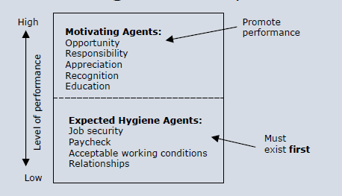
Herzberg’s theory of Motivation

Slide 31
Training, Coaching & Mentoring
Training is teaching a skill or knowledge through practice and instruction.
Coaching is a facilitated process to help individuals develop and improve performance
Mentoring is a professional relationship more free flowing. The mentor offers advice

Slide 32
Guidelines for One-On-One Coaching
Meet them a half a step ahead
Guarantee safety
Partner with managers
Create positive regard

Slide 33
Collaborative Team Spaces
Creating a collaborative team space

Slide 34
Collocated Teams are Preferred
All the team works in one location
Ideally with in 33 feet or ten meters of each other
No physical barriers like walls are doorways
Distributive teams is collaborative software

Slide 35
Creating a team space
Location for team members in the same space
Also known as the war room
Visible information radiators for project metrics
Lots of white boards and task boards

Slide 36
Caves and Commons
Caves are private spaces for phone calls or one-on-one conversations
Commons is the primary work area

Slide 37
Tacit Knowledge
The unwritten information collectively known by the group
How to restart a server
How to turn on the lights
Larger groups have more difficulty with tacit knowledge

Slide 38
Osmotic Communication
Learning by overhearing each other’s conversation
Benefit of a collocated team

Slide 39
Managing Virtual Teams
Consider different time zones
Consider different cultures
Different communication styles
Different native languages

Slide 40
Managing Distributed Teams
Distributed teams are virtual teams
Short iterations help collaboration in coordination
Distributed teams is not the same as outsourcing
Distributed teams faced more of a challenge it was storming and norming
The project manager may need to introduce controversial or difficulties of the work early in the project
A face-to-face kickoff is often needed

Slide 41
Digital Tools for Distributed Teams
Video conferencing it like that
Interactive whiteboard
Instant messaging
Presence based application
Electronic task for the storyboards
Web-based meeting facilitators
Virtual card wall
Wiki site

Slide 42
Tracking Team Performance
Monitoring Progress and Performance

Slide 43
Utilizing Burndown Chart
Track the work that remains to be done on a project
Measures the team progress in completing the project work
Track the work that has been completed
As work is done the line moves upward
Provides additional insight into the project status

Slide 44
Understanding Team Velocity
Velocity is the measure of a team’s capacity for work per iteration
Measured in the same unit that the team estimates the work
Velocity very early and then stabilizes
Velocity tends to plateau

Slide 45
Calculating Completion Time
The team’s velocity has been 20 story points per iteration
There are 200 story points left
Each iteration is two weeks
200 divided by 20 is 10
10 times 2 is 20
There are 20 weeks left in the project

Slide 46

Domain Completion
PMI-ACP
You have successfully completed –
Team Performance domain

